Slide 1
Primary Care Specialist Pharmacy Services
Carl Holvey
Lead clinical and Deputy chief pharmacist

Slide 2
Primary Care Mental Health Pharmacy Services
Clear unmet need in primary care
Top ways to impact on patient care
Ways in which to fund services

Slide 3
State of play
Those with severe mental illnesses are:
more likely to die 15-20 years prematurely
more likely to have cardiovascular disease and diabetes,
smoke twice as much
and seek treatment for physical health
conditions
…than the general population
Notes:
What is repeat prescribing?
It enables a patient to obtain further supplies of their regular medication for long term conditions without routinely having to see the doctor, thereby reducing unnecessary consultations. It is an essential part of everyday health care within the NHS, and accounts for about 2/3 of all prescriptions written by GPs, and 80% of medicines costs.
It is estimated that 1.9 million prescriptions are issued in England in each day, meaning that approximately
1.26 million prescriptions are issued each day for repeat items. So it is important to general practice staff and patients that an efficient and effective repeat prescribing process is in place.

Slide 4
Mental health support in primary care
24% of people in England with a common mental health problem receive treatment
1 in 3 GP appointments involves a mental health component
9.9 million people will have mental health problems by 2026
300/1,000/yr experience mental health problems
230 visit a GP, 102 will be diagnosed
24 referred to a specialist
6 inpatients in a psychiatric hospital.

Slide 5
Dave….
80yr old boxer
Saw the death of cousin and father in 20’s
Images haunted him and took Tuinal.
Switched to lormetazolam in the 80’s been in it since…
Has had many driving accents and falls throughout his life….not a bone he hasn’t broken.

Slide 6
Specialist Services…
Primary Care Mental Health Pharmacist Clinics
Mental health Pharmacist review and written ScriptSwitch messages
Sector-wide review/management of the drugs spend
Virtual Specialist Pharmacist Review Service
Community Physical Health & Medicines Reconciliation

Slide 7
Focus…
Old, more risky or less effective prescribing
TCAs
Benzodiazepines/z-drugs
Combination antipsychotics
Review of patients taking lithium
Others:
Branded psychotropics, buspirone, amisulpride, melatonin (unlicensed), long term antidepressants, reboxetine, duloxetine (for depression)…

Slide 8
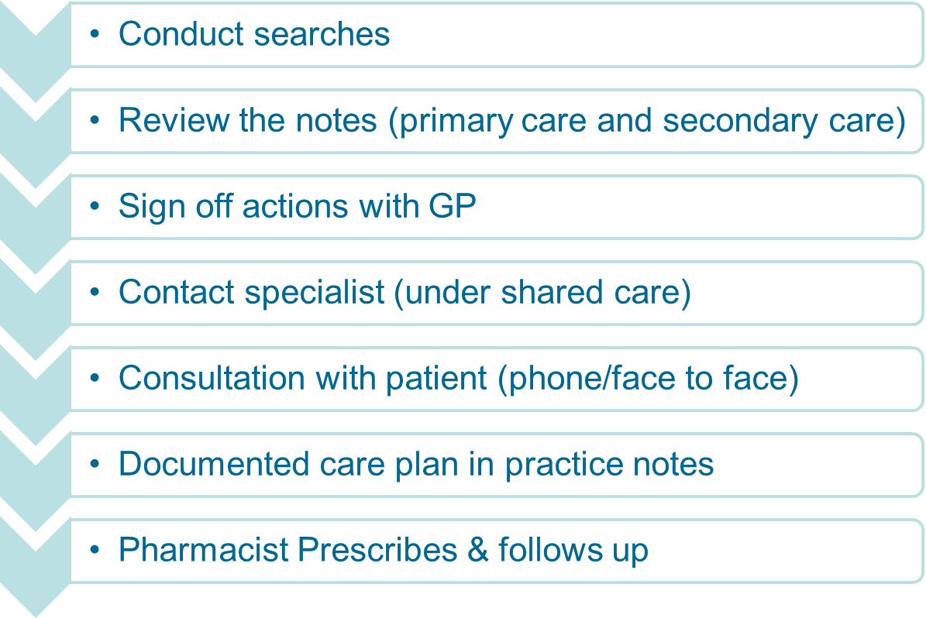
MMT!

Slide 9
GP Prescribing Mental Health Pharmacist
8,000 pt
466 long term benzo’s
160 to review face to face
60 specialist to review
40 dementia in care homes
206 Physical health complaint (spasticity, ankylosing
spondylosis, epilepsy, migraine etc…)

Slide 10
So what do you actually do & can you do it safely?
Full Mental state
Assessment of Activities of daily living
Sleep assessment
Practice work in 2002 at Adur, Arun & Arundel PCG
IPresc at KCL in 2008
Practitioner in Old Age Psych liaison
Rx for dementia, delirium, & BPSD at GSTT
Practitioner prescribing for HTT

Slide 11
The 45min assessment…..
The discussion…CBT, motivational interviewing, cycle of change & …
Find the hooks
Your notes don’t tell me much about how you came to be on it can you tell me about it?
So you fall asleep within 10mins of taking…
So, you lived for 40yrs without sedatives for sleep, what is it that makes you need them now…
You’re worried about falling and have had some close shaves recently…

Slide 12
Dave….
Enjoyed sex and drinking….had a partner.
Felt sleeping in the morning
No signs of mental illness, no flash backs of the deaths since his 40’s
MSE –NAD
Risk –withdrawal

Slide 13
The Risks…
Switching meds for chronic illness X
Refer (?PDD, tinnitus, urology) or treat
Suicidality
Emergency contacts
Personal indemnity

Slide 14
Results from one practice…..
68% stopped/ reduced
15 years on average taking the medicines
238 years talking the medicines
Likely to have saved 6.2 falls and 6 referrals
£160K and £45K
0 of 6 patients taking lithium, level in the past 6 months
Feedback
‘no one ever told me they were addictive’
‘It’s been seem less’
‘hot news from my hot bed’
‘If we’re doing it together, I’ll try’

Slide 15
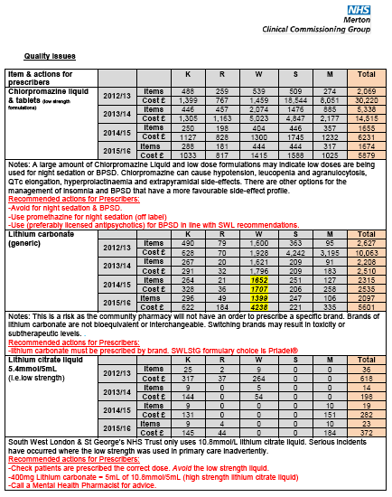
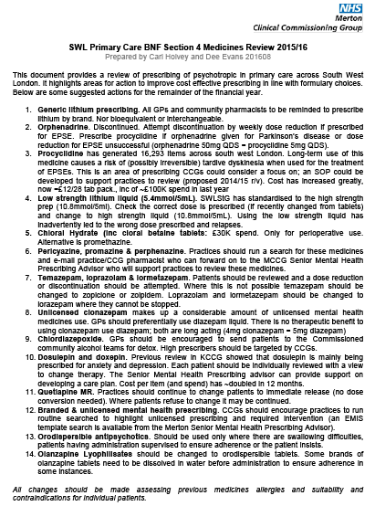
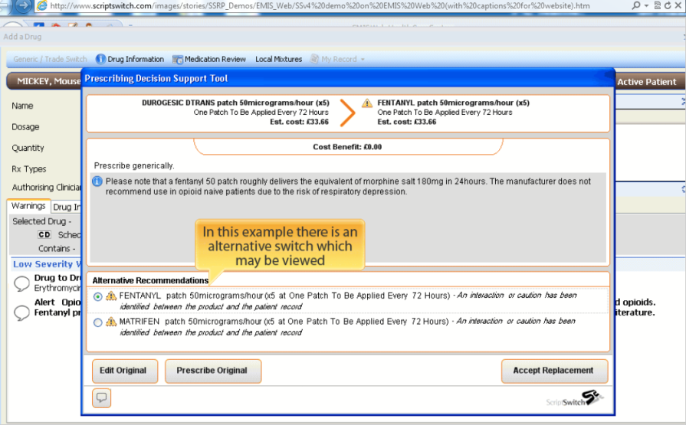
ScriptSwitch & Primary & Acute Care Rx review
Sector wide and MHT led changes in prescribing
CCG lead commissioners in MH
Whole systems approach to NHS spend and quality improvement
Process and support for all sectors to implement the formulary and quality improvement projects.

Slide 16
Dave….
Was costing ~170 quid per month…
….not to mention the 100,000 he cost the NHS to care for him after his falls and accidents

Slide 17
Virtual Commission Support Advisory Service
1
Run searches recommended by the CCG Mental Health Pharmacist to provide support
2
Practice to undertake interventions to improve safety and quality.
3
Practice sends list of prescribing details (with patient summary sheet) to the CCG Mental Health Pharmacist to provide support .deirdre.evans2@nhs.net
Care plans provded for individual patients by the CCG Mental Health Pharmacist to the practice.
4
Practices are responsible for reviewing the advice and applying it to the patient based on their clincial and historical knowlege of the paitent.
Suggested clinical interventions practices should seek advice on:
Switching dosulepin, Pericyazine, promazine & perphenazine.
Switching high dose: Temazepam (>20mg/day), lorpazoplam or lormetazepam (>4mg/day)
Switching barbiturates.
Switches that have not previously been done by practices that they are not confident to undertake.

Slide 18
So who pays?
CCG Pharmacy Advisory Service sector-wide resource
Policy, procedure, prescribing review, Acute Health formulary
review, sector wide audit and GP resource preparation,
GP Prescribing Mental Health Pharmacist
GP Practice Medicines incentive scheme
MHT commissioned primary care outreach service

